Slide 1


Solids Handling
Southeast Section Workshop
August 12-13, 2026
Roswell Convention Center
912 North Main St.
Roswell NM 88201

Slide 2
AMY NORTHAM, PA, CPM
TWUA Instructor
Lab Director & Operations Supervisor – Village of Ruidoso
Director of Wastewater – Levelland, TX
Lab Tech, Operations, & Shift Leader – Lubbock, TX
NM Level IV Wastewater License
NM Level III Lab License
TX Level A Wastewater License
(806) 535-5414 cell
AmyN@wuci-sw.com
https://wuci-sw.com/

Slide 3
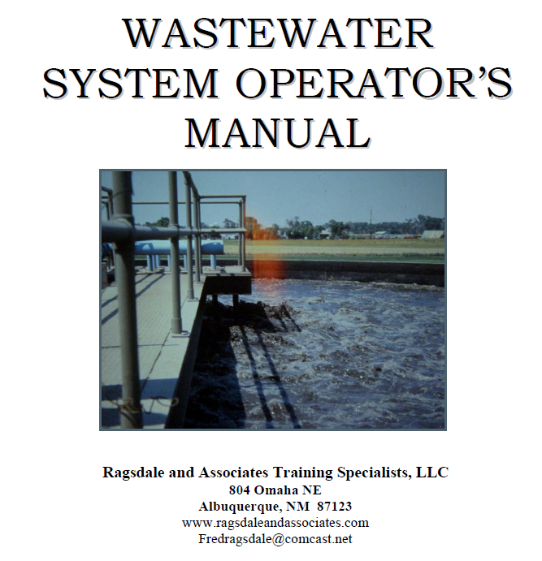
Study Material
Chapter 4:
Solids Handling
pg. 4-1
Chapter 5:
Digesters
pg. 5-1
https://www.nmwwa.org/_files/ugd/a8472e_ef77517d1bab42b08f7ae0f99d98005d.pdf

Slide 4

QR Code to download pdf handout for slides and practice exam.

Slide 5
SOLIDS HANDLING
Solids, known as sludge, must be stabilized and reduced in volume before they can be reused or disposed of economically and safely
The processes used to stabilize sludge and reduce its volume are known as solids handling.
  Includes
    Thickening
    Digestion
    Dewatering
    Disposal
Types of Sludge
  Primary sludge
  Trickling filter humus sludge
  Activated sludge
  Digested sludge
Solids must be thoroughly stabilized in order to avoid problems:
  odors
  human exposure to pathogenic organisms
  attraction of vectors (mice, dogs, birds).
Biological digestion is the process most often used to stabilize sludge
Chemical Stabilization
  addition of large doses of lime
  temporary - mainly for upsets
  costly

Slide 6
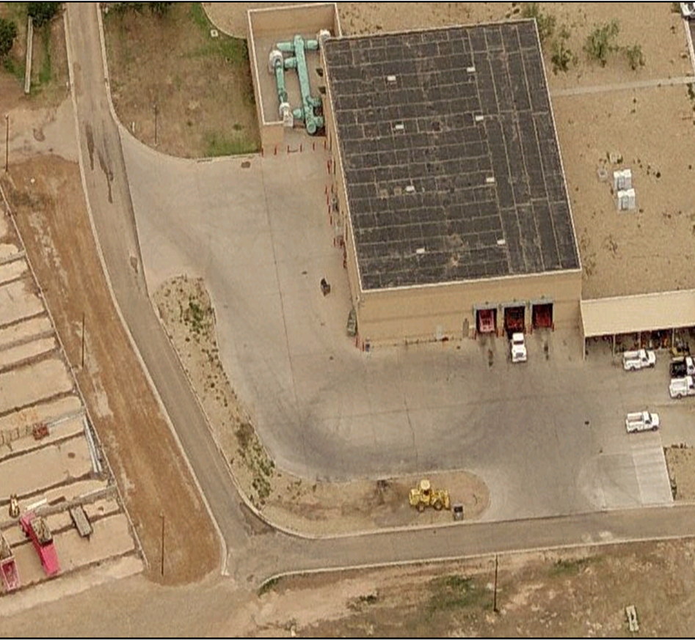
Aerial View
Solids Building and Drying Beds SEWRP

Slide 7
SOLIDS HANDLING
Dry solids content about 2%
All solids handling processes create side stream flows that are returned to the head of the plant
High in BOD and suspended solids and usually have no DO
Tests for BOD and SS should be run on:
  thickener overflow
  supernatant
  other solids handling side streams
  every shift
Suspended solids are again settled in the primary clarifiers, but the organics that are present are mostly dissolved.
The secondary processes must deal with the majority of the BOD that is being returned and must be taken into calculation considerations

Slide 8
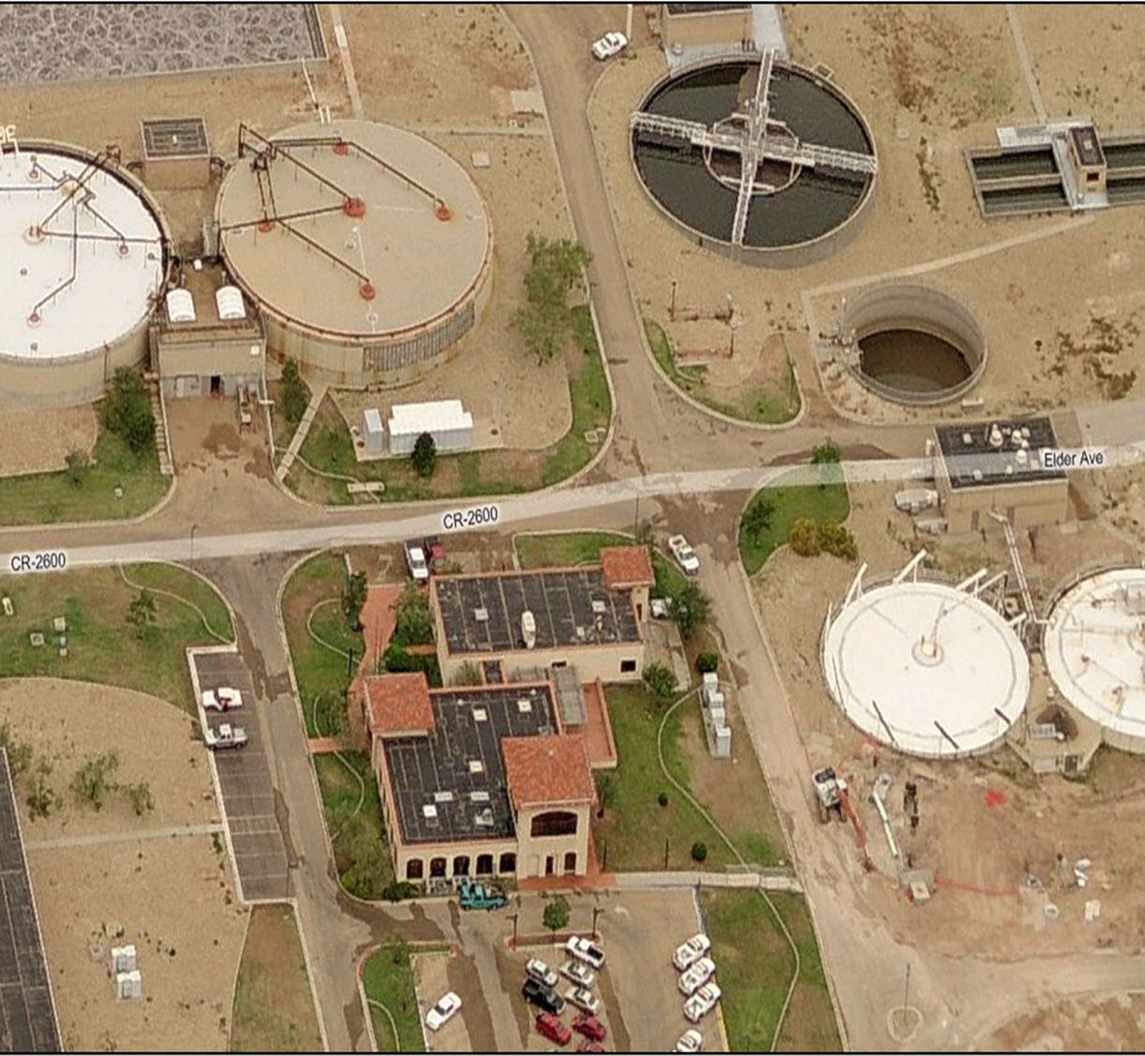
Aerial View
Digesters SEWRP

Slide 9
SOLIDS HANDLING
Solids handling incorporates four functions:
  Thickening
    decrease the amount of water that is handled by increasing the solids concentration
    double the solids concentration, the amount of water needed to move a pound of solids is cut in half
  Digestion
    “breaking down” sludge into simpler components through the action of microorganisms
    Aerobic
    Anaerobic
  Dewatering
    dewatering processes are located after digestion
    Chemicals (polymers) used to enhance many of the sludge dewatering and drying processes
    filter presses, vacuum filtration, belt presses, centrifuges and sludge drying beds
  Sludge disposal and/or reuse
    Sanitary landfill
    Land application
    Composted

Slide 10
Thickening

Slide 11
Thickening
Agglomeration (floc and cake)
Flotation (DAF)
A “thick” sludge, (5 – 6% total solids), still contains over 90% water
Processes thicken sludge but remains a liquid or slurry
  gravity thickeners
  diffused air floatation (DAF) units
  gravity belt thickeners
  rotary drum thickeners
Most commonly used before digestion
Polymers can aid in process and is referred to as conditioning
It is always best to NOT send thin sludge (or lots of water) to the anaerobic digester
Thickening normally increases the dry solids content to 4 – 6%.

Slide 12
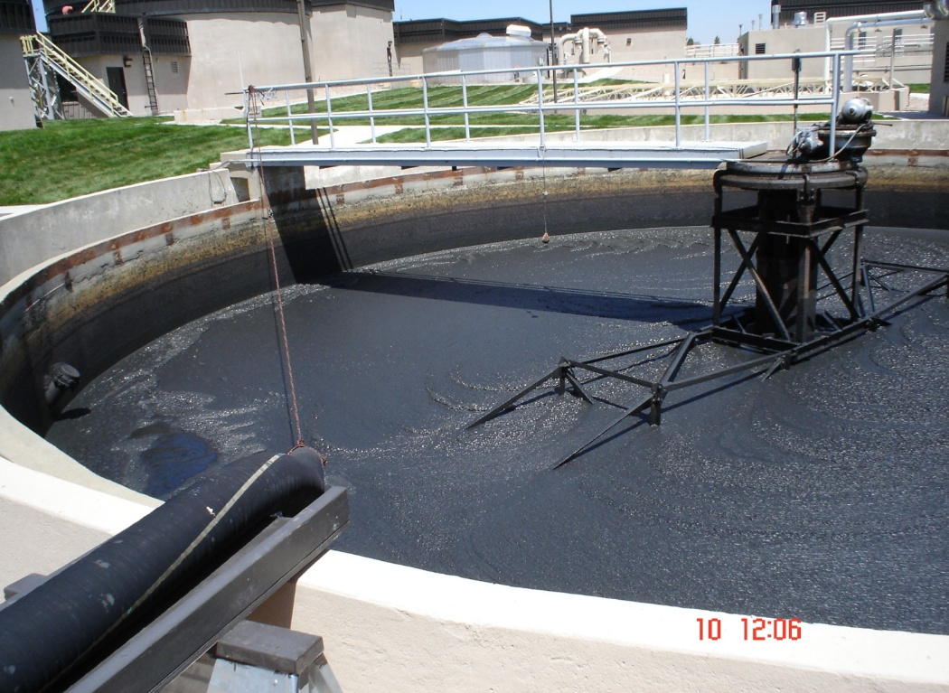
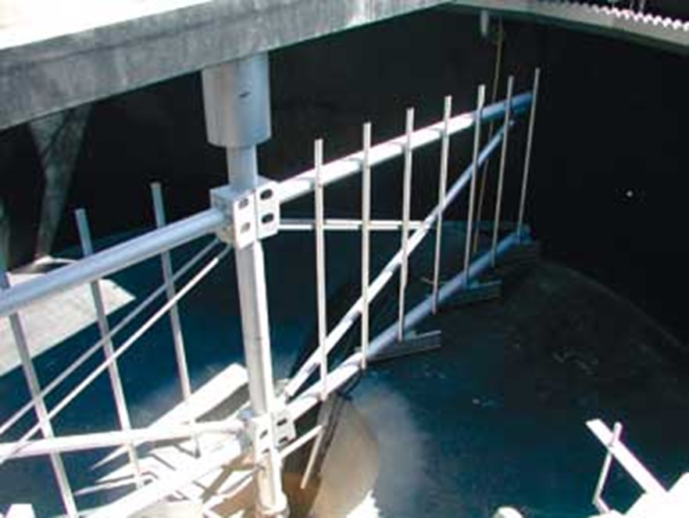
Gravity Thickeners
Uses gravitational forces to separate water from sludge and is mainly used on primary sludge
Scaled down clarifier
Process is identical but the unit is designed for heavier sludges and lower flows
Surface loading rates are about 400-800 gpd/ft².
Detention times vary from 1-2 days.
Solids loading on the unit is calculated in lbs/day/ft².
Can be thickened to 8-10% total solids but typically 2-6%
Poor thickener performance can cause organic overloading in the secondary process

Slide 13
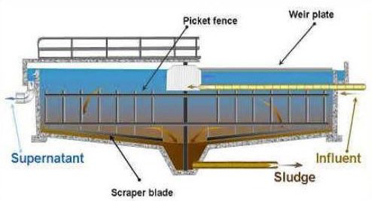
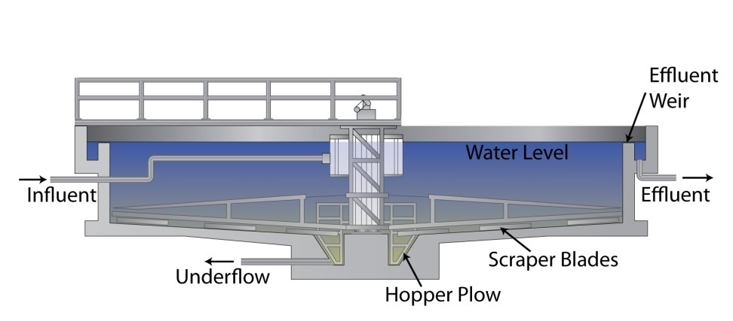
Gravity Thickeners
Efficiency depends on:
  Type of sludge being thickened
      Primary sludge thickens best, but must not be allowed to become septic
      Secondary & activated sludge is difficult due to their lower solids content and denitrification.
  Age of the feed sludge
      Older sludges prone to gasification from denitrification and septic conditions; floats
  Sludge temperature
    Warmer sludge settles better
    Shorter DT times in warmer weather because of gasification due to the increase in biological activity

Slide 14
Gravity Thickeners
Efficiency depends on:
Different zones of concentration:
  Sludge blanket depth
    compaction that occurs from the overlying sludge
    between 5-8 feet deep
  balance must be struck between maintaining blanket thickness and removing the solids before gasification
  Hydraulic and solids loading.
  Clarified Effluent Water Zone
    topmost zone
    free of solids
  Feed Zone
    does not necessarily have the same concentration of feed solids
    uniform solids concentration
  Compaction Zone
    increasing solids concentration
    from feed zone concentration to underflow concentration

Slide 15
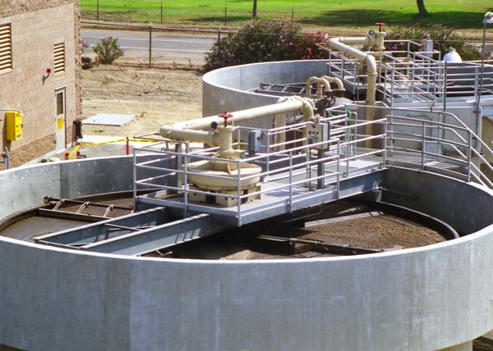
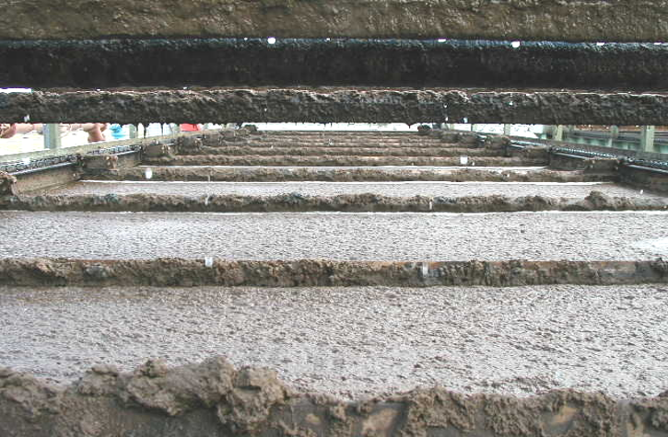
Diffused Air Floatation (DAF) Units
Uses air bubbles to float solids to the surface for removal.

Slide 16
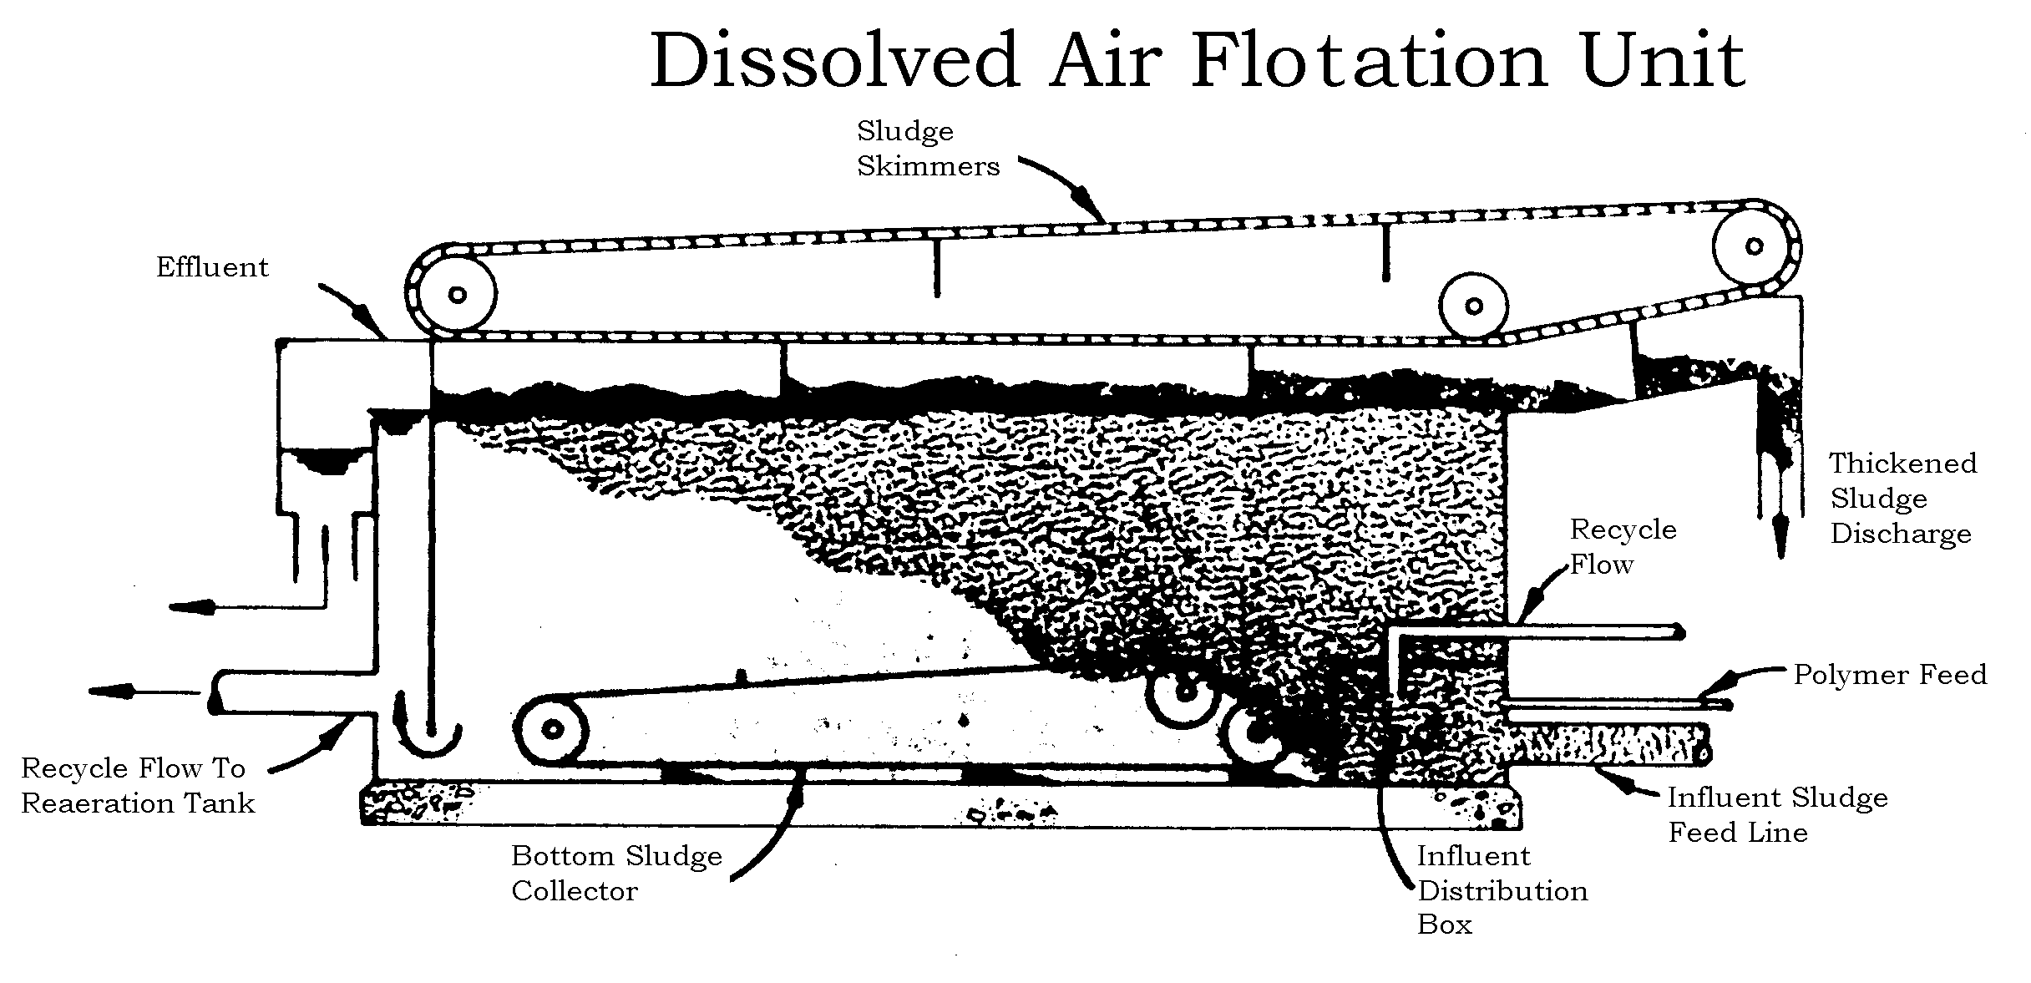
Diffused Air Floatation (DAF) Units

Slide 17
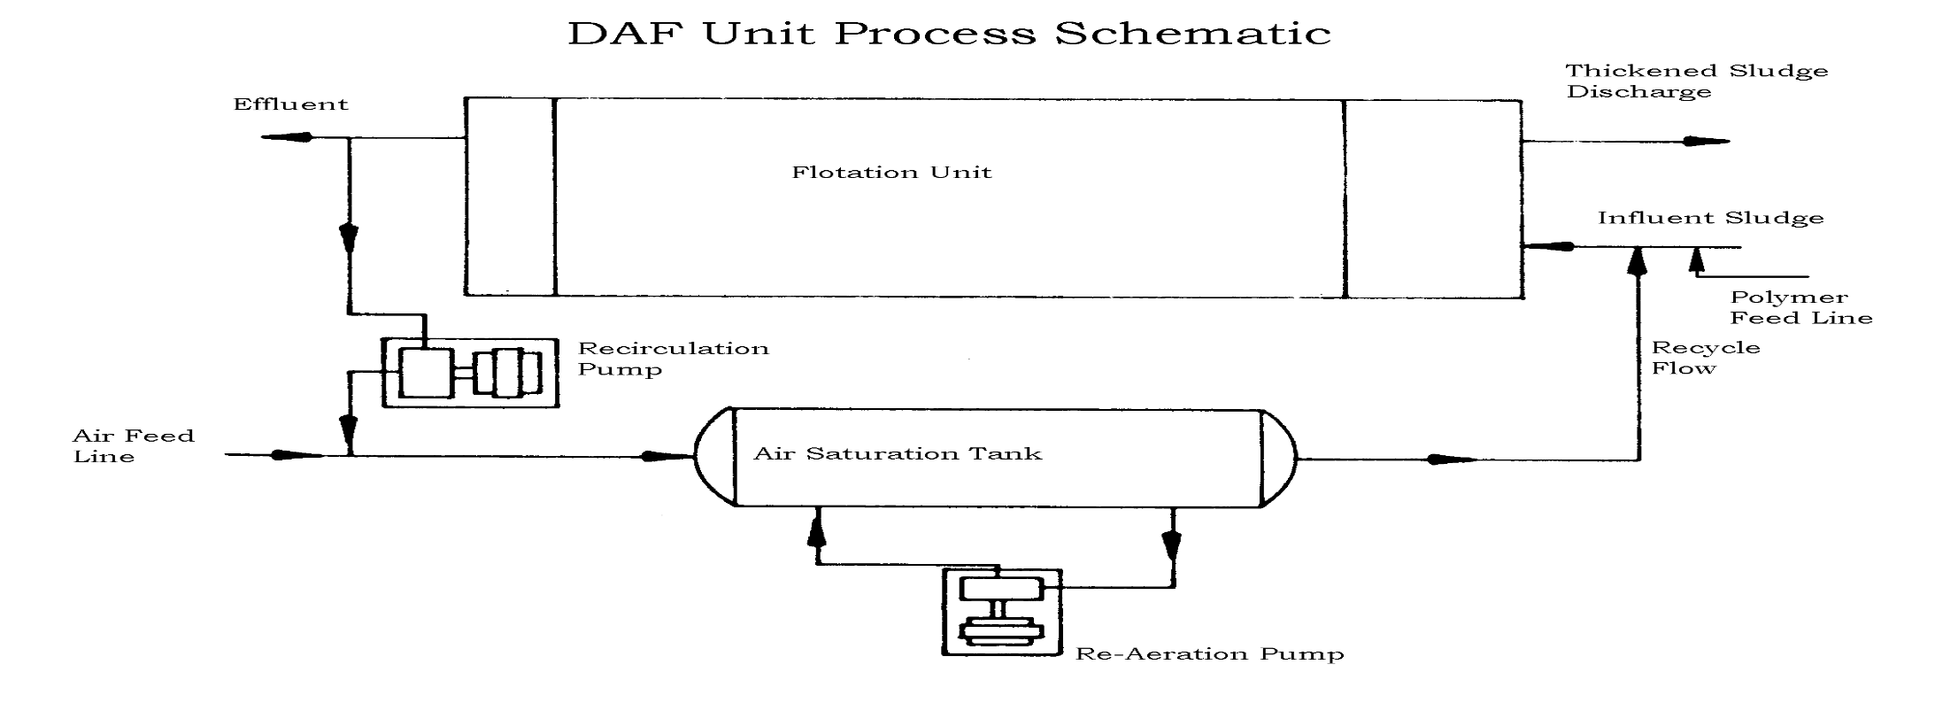
Diffused Air Floatation (DAF) Units

Slide 18
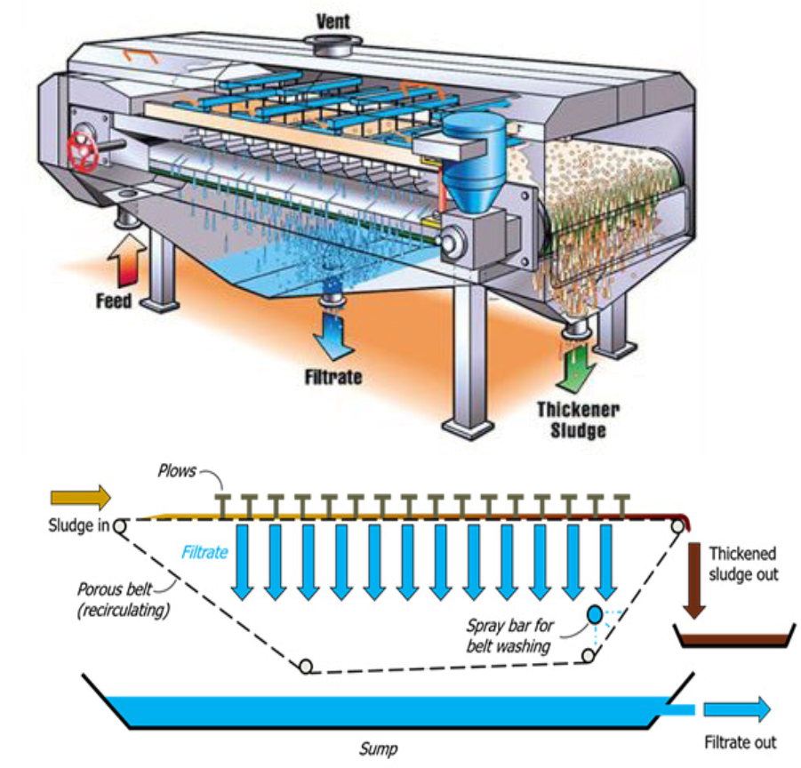
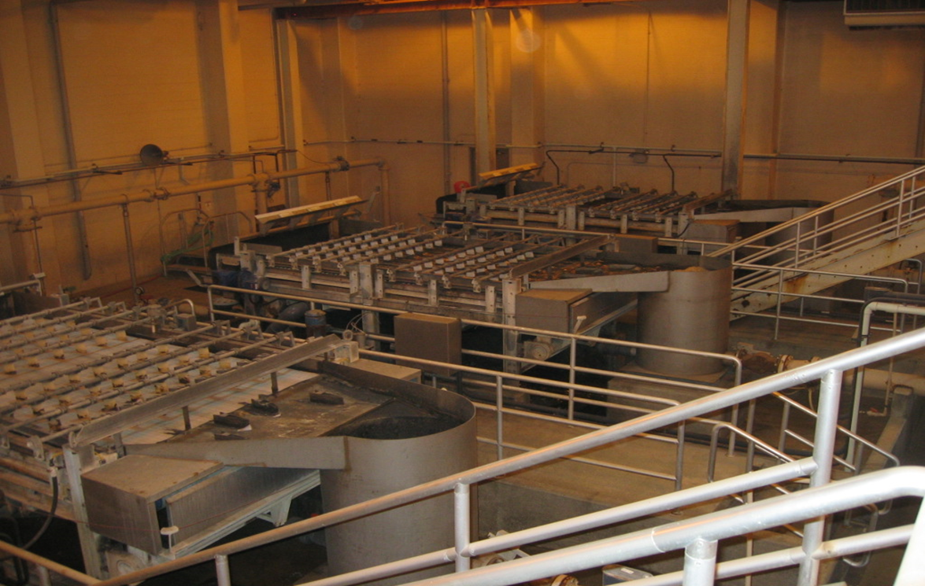
Gravity Belt Thickeners (GBT)
Uses a moving porous belt to drain water from sludge.

Slide 19
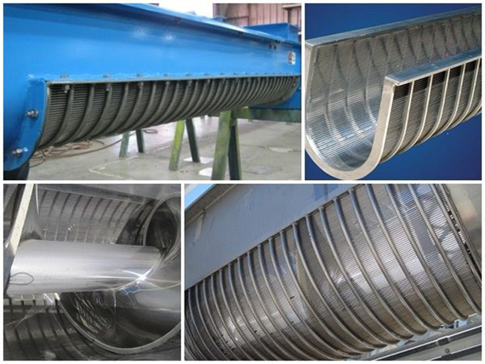
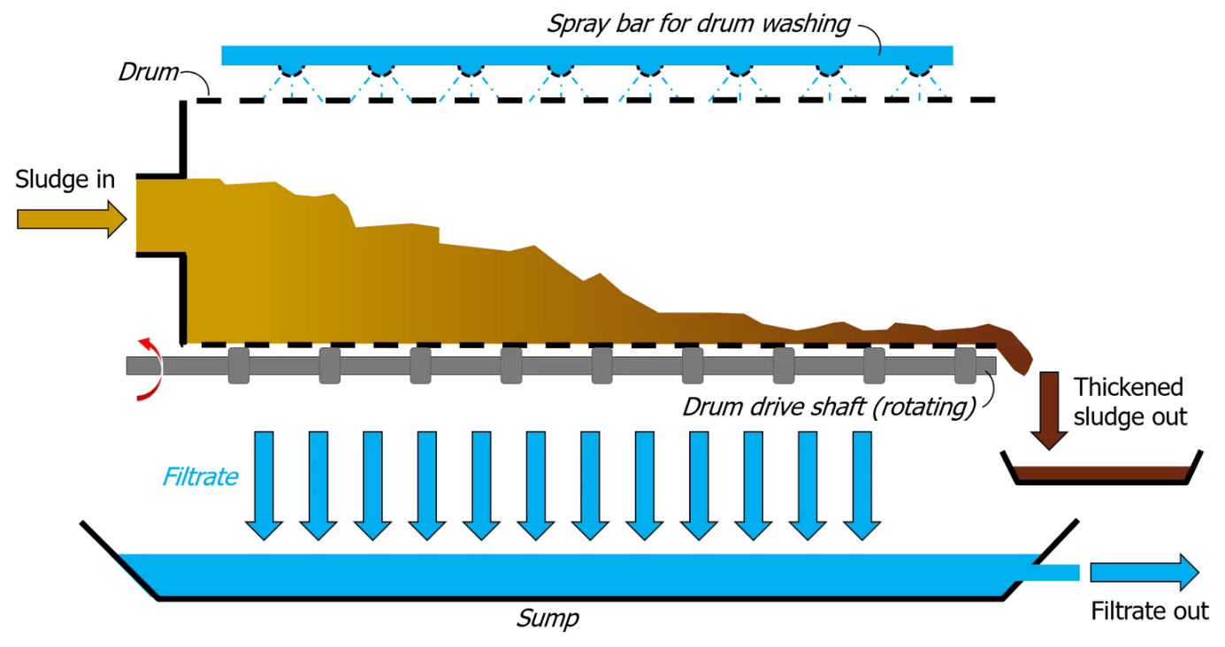
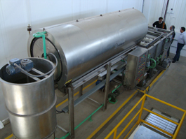
Rotary Drum Thickeners (RDT)
Uses a rotating drum to separate water from sludge.

Slide 20
Digestion

Slide 21
Digestion
Sludge digestion is the primary means of stabilizing the volatile organic material in the sludge
  Sludge from the secondary clarifiers is already partially stabilized
  Sludge produced by primary clarifiers is unstable, odorous and full of pathogenic bacteria (raw).
Biologically degradable organics (volatile solids) account for 60-65% of the total solids.
Releases most of the bound water in the sludge.
Sludge decomposes the organic material into gases:
  water vapor
  carbon dioxide (CO₂)
  methane (CH₄)
  hydrogen sulfide (H₂S)
Reduces the volume of sludge that will ultimately have to be landfilled, land applied, or composted.
Accomplished by either Anaerobic or Aerobic digestion
Only reduces the volume of organic material, not inorganic waste, such as grit or plastics.
Digested sludge is inoffensive, having the appearance and characteristics of a rich potting soil.

Slide 22
Anaerobic Digestion

Slide 23
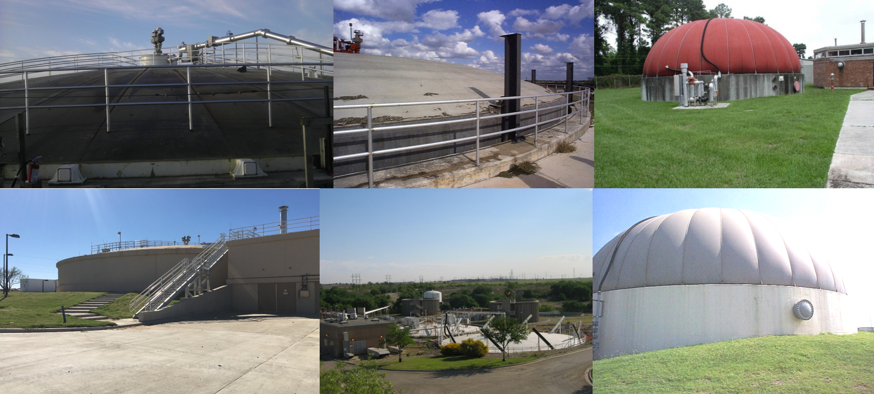
Anaerobic Digestion

Slide 24
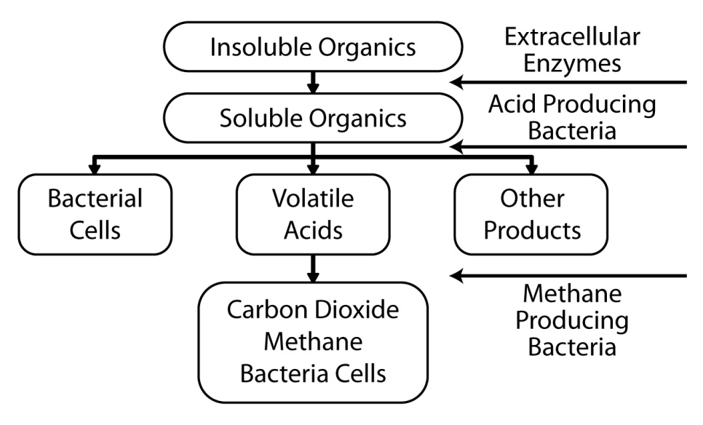
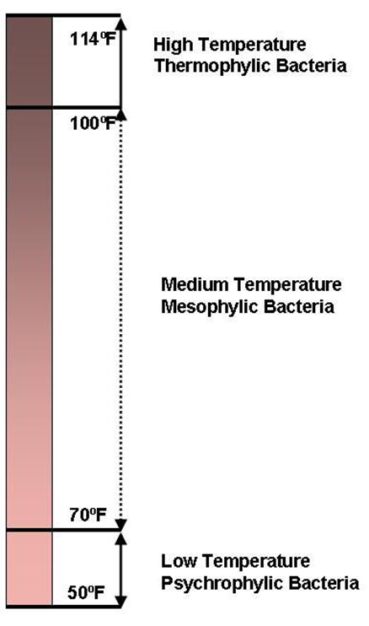
Anaerobic Digestion
Must occur in the absence of dissolved oxygen
In sealed tanks and systems to prevent atmospheric from interfering
Use oxygen that is chemically bound in organic compounds like sugars and starches
Stages of digestion
  Acid fermentation
  Methane fermentation
Types of digestion
  Low-temperature
  Medium-temperature
  High-temperature
Mixing and heating required
No more than 1°C/F per day change
Excess water causes upsets

Slide 25
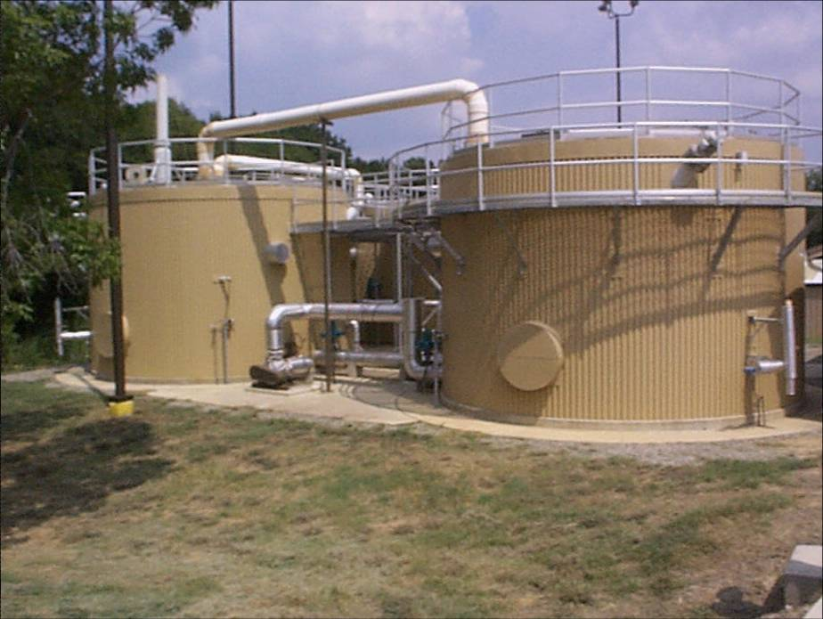
Anaerobic Digestion
Most anaerobic digesters are operated as a 2-stage process
  Primary - receives raw
    Mixed and heated
    Where most of the stabilization takes place
    Fixed cover
  Secondary
    Sludge solids are allowed to settle and drawn off for disposal
    'Dish water grey' supernatant draw off and sent back to primary
    Supernatant concentrated in ammonia and BOD with no DO
    Usually floating cover to allow for gas and sludge storage
    Serves as a source of seed organisms for the primary digester in case it becomes upset
Solids are reduced 50-60%

Slide 26
Anaerobic Digestion
Tanks
  Sized based on a solids loading rate of 0.15-0.35 lbs/day/ft³
  Cylindrical in shape
  Around 20 ft deep
  Sloped floors for sludge withdrawal
  May be double stacked (clarifier inside digester)
  Contains tubes or manifolds for supernatant removal
Covers
  Pressure Relief Valve – Top
  Vacuum Relief Valve – Middle
  Flame Arrester - Bottom
  Fixed
    Keep ambient O₂ out
    Handles gas processing equipment
    Limits capacity
  Floating
    Slide guides allow the cover to travel above the tank wall
    Uses 8-12 inches of water to maintain seal of gases
    Rapid rise or fall breaks seal
    Flexible capacity for gas and sludge
    Gas pressure in the system must be kept at less than 8 inches of water column to prevent the water seal from blowing out.
  Gas Holder
    PVC-coated polyester fabric membranes, stainless steel anchors

Slide 28
Anaerobic Digestion
Gas Handling Systems
  Contains a heat value of 500 – 600 BTU/ft³ (Natural gas contains 900 – 1200 BTU/ft³)
  The volatile solids concentration is reduced 50-60%, producing 8-12 ft³ of gas for every pound of volatile matter added.
  For every pound of volatile matter destroyed, 12-18 ft³ of gas is produced.
  The gas produced is composed of 65-70% methane and 30-35% carbon dioxide.
  Approximately 1-2% of the emitted gas contains nitrogen (N₂), hydrogen (H₂) and hydrogen sulfide (H₂S).
  Since anaerobic digestion is an anaerobic process, if air enters the digester, an explosive mixture of gases can result.
  Often reused for mixing and heating

Slide 29
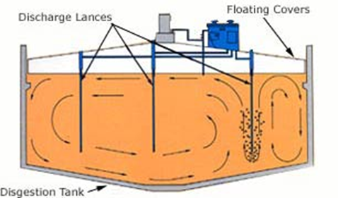
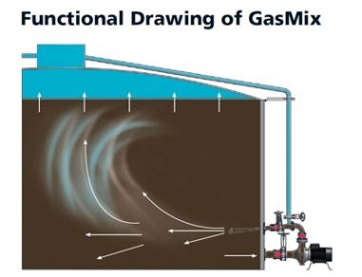
Anaerobic Digestion
Mixing and Heating
  Mechanical mixers that utilize propellers and draft tubes are common.
  Mixers that work by compressing and bubbling methane gas into the sludge are also used.
  A boiler fired off of digester gas, natural gas or propane typically provides the heat for the digester.
  Boiler water is best maintained at between 60 and 82°C.
  2 common methods of heat exchange:
    sludge recirculation through an external heat exchanger
    heat exchangers located inside the digester

Slide 30
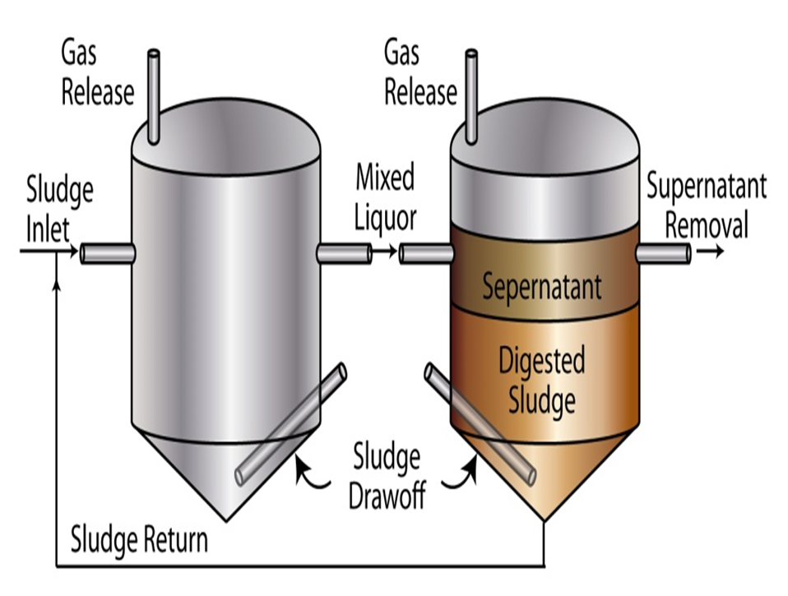
Anaerobic Digestion
Piping
    Sludge Feed (inlet) Line
    Supernatant Tubes
    Sludge Draw-Off Lines
  Must be able to withstand pumping pressures and severe corrosion
  Cast iron or steel is typically used
  Struvite is magnesium ammonium phosphate (NH₄MgPO₄•6H₂O) which causes hard scale on the inside of the piping system and clogs piping
  Controlled by adding iron salts (ferric chloride, FeCl₃) to react with the phosphorus, preventing the formation of struvite.
  Higher the wastewater pH, the more likely struvite crystals form.
Enzymes break down the solid organic compounds into:
  organic fatty acids
  alcohol
  carbon dioxide (CO₂)
  ammonia (NH₃)

Slide 31
Anaerobic Digestion
Acid Stage
  Facultative acid-producing bacteria (saprophytic) take complex raw organic compounds, like sugars and starches, and break them down into organic acids
  H₂S and CO₂ are produced
  Lowers pH
    Important to maintain enough alkalinity to buffer the effect of the acids.
    Necessary to keep the pH above 7.0 and maintain maximum methane production
  Nitrogen content is about 1% - 5%
  Reduces volatile solids content of the sludge by 30 – 60%
  pH not good process control
  Volatile Acid/Alkalinity Ratio is key parameter when monitoring the health of the anaerobic digester
    Running volatile acids and alkalinity tests is an important part of efficient digester operations.
    The VA/ALK ratio will change before the pH begins to drop.
    Upsets and foaming occur when acid production is not buffered (heartburn)
    VA/ALK ≤ 0.1 optimal

Slide 32
Anaerobic Digestion
Methane Fermentation Stage
  Not as abundant as acid producers in raw wastewater due to narrow pH range => Easy to kill, hard to grow
  Takes the organic acids from the acid formers and converts them into methane (CH₄)
  Ammonia (NH₃) production neutralizes the acid production and the pH begins to rise.
  Stabilization will occur with the production of Methane
  Methane gas = 65% - 75%
  Methane fermenters (methanogens) will not work or reproduce if the pH is < 6.6 or > 7.6. (picky eaters)
  They work best when the pH is 7.0-7.2.
  CH₄ (blue flame) and H₂S & CO₂ (yellow/orange flame) gas must be either scrubbed and reused as fuel or flared off
Low-temperature
  Psychrophilic bacteria
  Rare design--unheated Imhoff tank digesters and septic tanks
  Slow process, 50-120 days to stabilize sludge
  Large amounts of CO₂ & H₂S
  No methane gas production
  Plenty of odor due to no gas collection/flare
  Operating temperature 50 - 70°F (10 - 20°C)
  Poor separation of solids and liquids
  Supernatant high in BOD and TSS
  pH 5.1 - 6.8

Slide 33
Anaerobic Digestion
Medium-temperature
  Mesophilic bacteria
  70 - 100°F (20 - 45°C)
  85-100°F Optimal
  95 - 98°F Operating
  Detention Time 25-30 days
  CO₂, CH₄ and NH₃ production
  65-70% CH₄ & 30% CO₂
  8-12 ft³ of digester gas for every pound of organics
  500-800 BTU/ft³
  pH close to neutral (7)
  Mixed
  Good solids separation from liquid
  Favors bacterial growth
  Most common design
High-temperature
  Thermophilic bacteria
  Highest temperature range 120 - 135°F (49 - 57°C)
  Operating range 124 - 126°F (51 - 52°C)
  Rapid digestion
  Increased gas
  Poor separation of liquids from solids
  Detention time of 5-12 days required
  More energy to heat the system and negates any advantage from the increase
  Heat exchangers or heating coil temperature approach 130°F, sludge begins to cake on the piping
  Few plants operate in this range

Slide 34
Anaerobic Digestion
Basic Troubleshooting Concepts
Operators should be aware of signs that a digester is not functioning properly:
  Strong odors
  Foaming
  Poor gas production
  Unstable pH
  High volatile acids
  Low alkalinity
  Poor sludge quality
If these conditions occur, operators notify supervisors or higher‑level operators who perform testing and adjustments

Slide 35
Older Anaerobic Digesters
Imhoff Digester
Anaerobic Clarigester
Upflow Anaerobic Sludge Blanket (UASB)

Slide 36
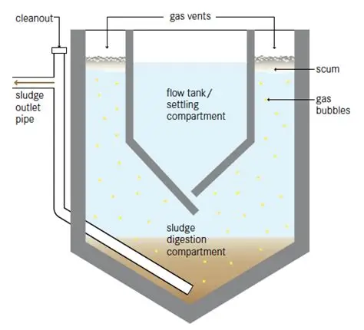
Imhoff Tank
The Imhoff tank is the ancestor of both the clarigester and the modern anaerobic digester. It was the first practical design to combine settling and digestion in one structure: a true “two‑story” tank.
How it works (Basic‑safe explanation):
  Upper chamber: acts as a primary clarifier where solids settle out.
  Lower chamber: acts as an anaerobic digester, where settled sludge slowly decomposes.
  Gas vents allow CO₂ and H₂S to escape.
  No heating or mixing — it’s a psychrophilic (low‑temperature) process.
  Supernatant returns to the plant for further treatment.
  Sludge is partially stabilized before withdrawal.
  Psychrophilic (cold-loving) anaerobic bacteria operate in a range from 50-68˚F

Slide 37
Anaerobic Clarigester
A clarigester is a combined primary clarifier and anaerobic digester used in older municipal plants and still found today in feedlots, wineries, and small biogas facilities.
How it works:
  Wastewater enters the upper clarifier zone, where solids settle out.
  Settled sludge drops into the lower digestion zone, where anaerobic bacteria slowly stabilize it.
  Gas vents through the top, releasing CO₂ and small amounts of methane.
  Supernatant returns to the plant or process for further treatment.
  Sludge is partially stabilized before withdrawal and may be reused or further digested.
  No heating or mechanical mixing — relies on natural psychrophilic digestion.
  Retention time is long (weeks to months), allowing gradual breakdown of organics.
Modern applications:
  Still used in agricultural and industrial wastewater where flow and solids are high but energy input must stay low.
  Common in feedlots, wineries, distilleries, and small biogas plants for primary treatment and gas recovery.
  Favored for simplicity, low maintenance, and low energy demand.
  Often paired with secondary anaerobic digesters or lagoons for complete stabilization.

Slide 38
Upflow Anaerobic Sludge Blanket (UASB)
A UASB reactor is a modern evolution of the old clarigester idea. It’s still an anaerobic digester, but instead of settling sludge downward, it pushes wastewater upward through a dense “sludge blanket” of active bacteria.
How it works:
  Influent enters at the bottom and flows upward through the sludge blanket.
  Bacteria digest organics as the water rises, producing methane and carbon dioxide.
  Gas bubbles help keep the sludge blanket mixed.
  Effluent exits at the top, where solids settle back down to maintain the blanket.
  Gas is collected for reuse or flaring.

Slide 39
Anaerobic Contact Process (ACP)
The ACP is the modern, controlled version of anaerobic digestion. It keeps the same biological principles as the old clarigester and UASB but adds separate zones and recirculation to make the process faster, cleaner, and more stable.
How it works (Basic‑safe explanation):
  Influent enters the digestion tank, where anaerobic bacteria break down organics.
  Gas is collected for reuse or flaring.
  Effluent flows to a separate settling tank, where solids settle out.
  Settled sludge is recycled back to the digester to maintain the active bacterial population.
  Clear supernatant leaves the system for further treatment.

Slide 40
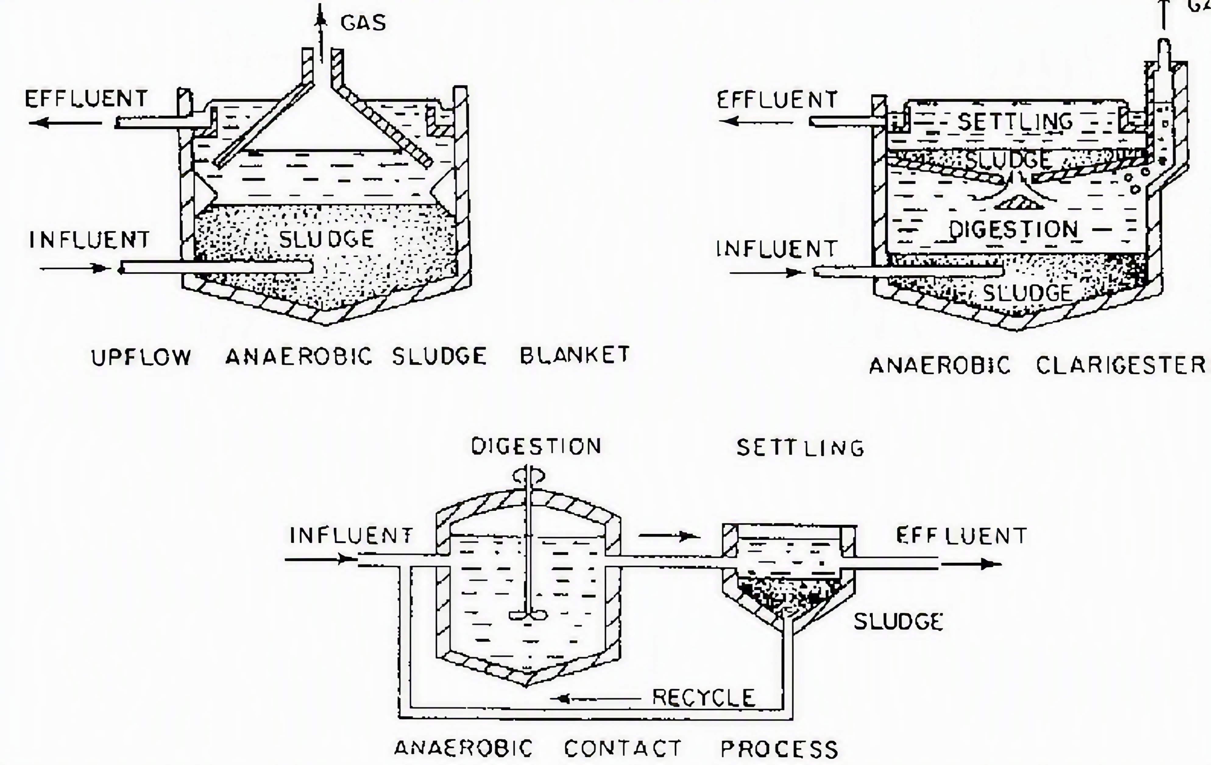
Comparison of Anaerobic Digestion Systems

Slide 41
Comparison of Anaerobic Digestion Systems
System | Era | Flow Direction | Heating | Mixing | Gas Handling | Efficiency | Notes
Imhoff Tank | Early 1900s | Downward | None | None | Minimal | Low | First combined clarifier‑digester; simple gravity flow
Clarigester | Mid 1900s | Downward | None | None | Minimal | Moderate | Improved sludge flow and gas venting; unheated
UASB (Upflow Anaerobic Sludge Blanket) | Late 1900s | Upward | Often mesophilic (85–100 °F) | Gas‑induced | Moderate | High | Compact, efficient, modern industrial design
ACP (Anaerobic Contact Process) | Current | Controlled flow with recycle | Heated and controlled | Mechanical or pumped | Fully collected and reused | Highest | Modern municipal standard; best solids separation and gas recovery

Slide 42
Aerobic Digestion

Slide 43
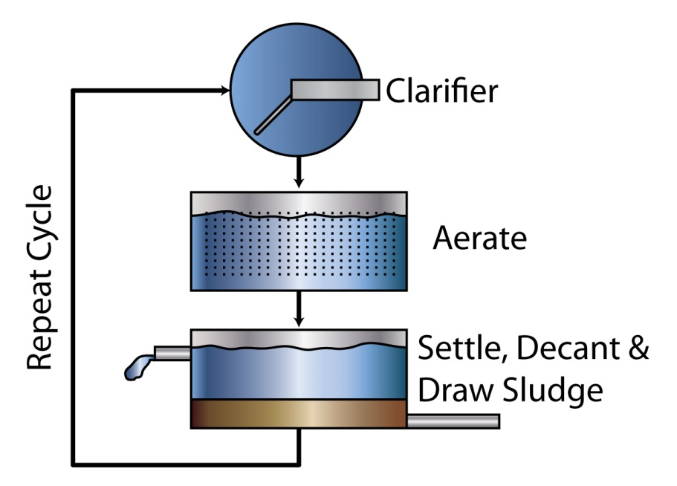
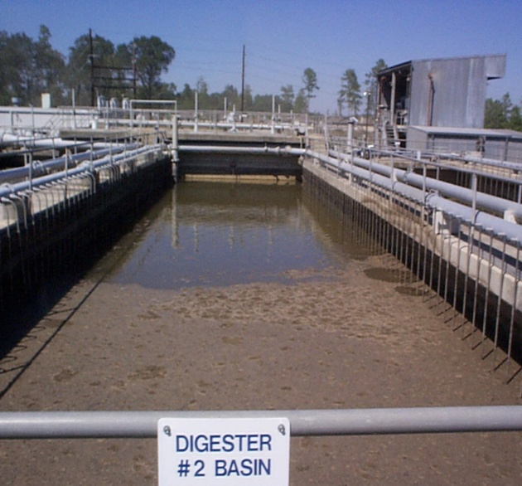
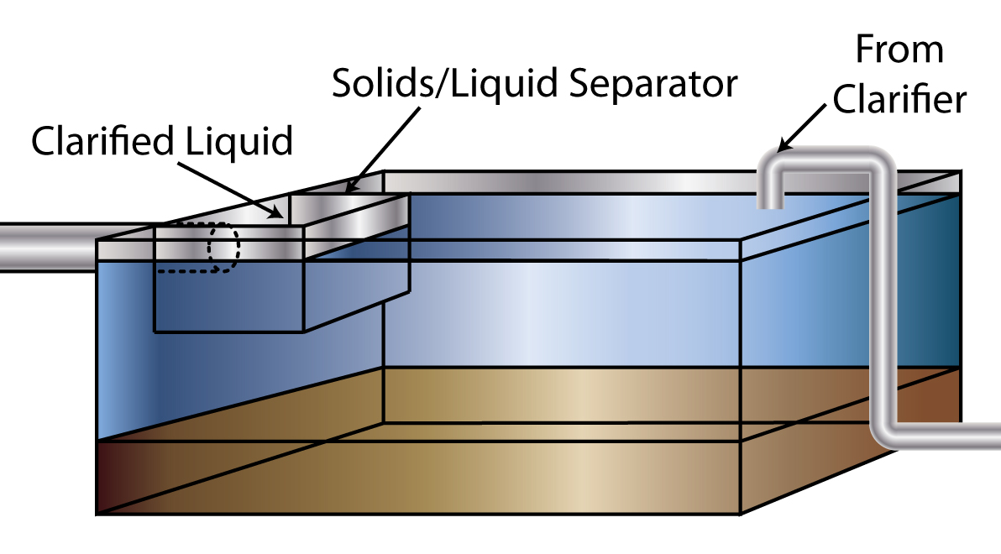
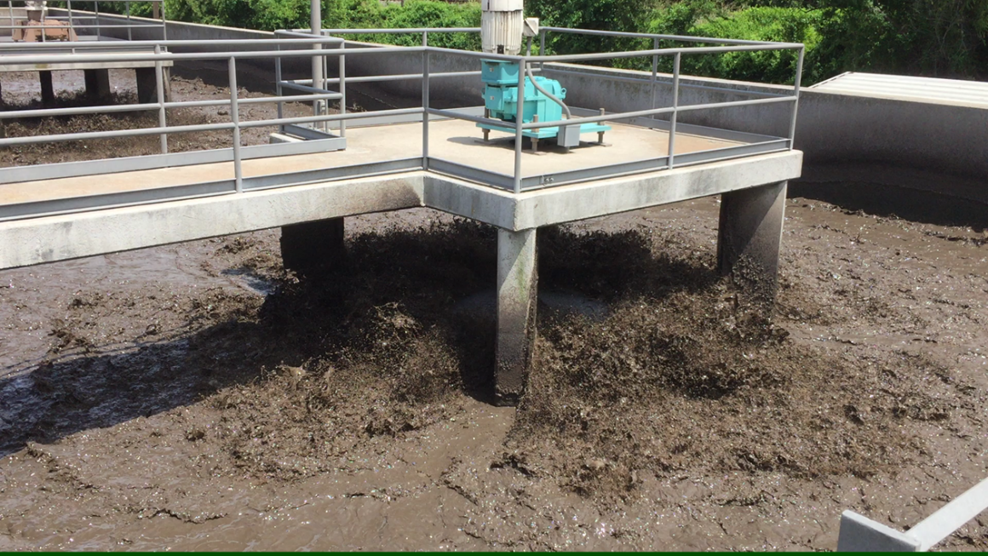
Aerobic Digestion

Slide 44
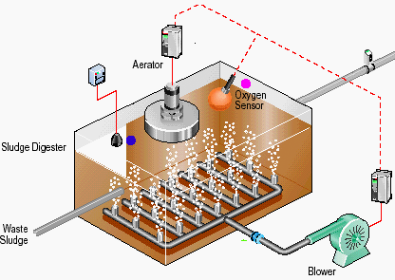
Aerobic Digestion

Slide 45
Aerobic Digestion
Aerobic digesters resemble an extended aeration activated sludge process in that it retains the solids until nearly all of the volatile solids have been stabilized.
Not as efficient as anaerobic digestion
WAS & trickling filter humus can be mixed with primary sludge and sent to the digester for further decomposition
Suitable for small to medium sized treatment plants
Built with multiple tanks or stages
18-20 feet deep
Aerated by diffuser headers
DO level of 1 - 2 mg/L must be maintained
pH 6.8 - 7.4
Brownish color
Very little odor
Produce a “rotten melon” odor that becomes progressively more offensive
DT = 25 - 45 days
TS in aerobic digesters typically range from 1.5 –4%
Volatile solids reduction 20–40%
If sludge is to be applied to land it must be kept under aeration for at least 45 days
Sludge lines should be a minimum of 3 inches in diameter to prevent plugging from grease, rags, etc.
If falls to unacceptable levels, empty and clean for sediment

Slide 46
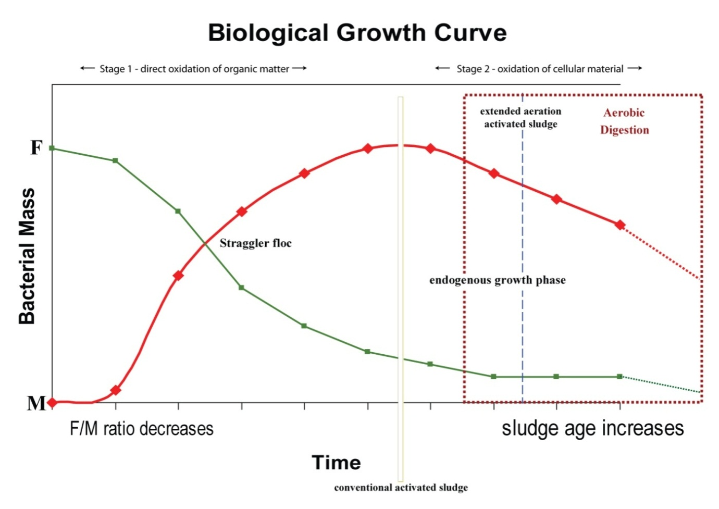
Aerobic Digestion

Slide 47
Aerobic Digestion
Achieve proper digestion w/o offensive odors:
  Organisms must be kept at their highest level of metabolism
  Endogenous respiration is cycle of organism eating organism because no food source is provided to the organisms in the tank other than more organisms (sludge) which breaks down the sludge
  Level of pathogens is significantly lowered
Overflow is returned to the head of the plant
  May still have a high organic strength
If operated at thermophilic temperatures:
  Loss of nitrifiers creates high nitrate concentrations
  More oxygen is needed and either has to come from purer source and volume ↑
Should be taken off-line and completely cleaned at least once every three years
Aerators should be shut down for 30-60 minutes prior to wasting
  Allows for settling to occur
  Results in lower solids in the supernate
  Supernatant draw off is not always a good practice.
  Aerobic sludge does not usually settle well and leave a clear supernatant (without the use of settling aids)
  If the digester aeration system cannot maintain at least 1.0 mg/L, the supernatant itself can be a source of filamentous organisms
Difficult to dewater w/o polymers
Occasionally last stage of SBR process

Slide 48
Daily Monitoring &
Factors affecting Aerobic Digestion
Operators must monitor aerobic digesters daily to maintain stable digestion.
Temperature
    Affects activity and oxygen requirements
    NM desert heat can push digesters toward thermophilic range
    High temperatures cause:
      Loss of nitrifiers
      Increased nitrate concentrations
      Higher oxygen demand
  O₂ Requirements
    Maintain 1 – 2 mg/L DO in digester
    <1 mg/L → filamentous growth risk
  Mixing & Odor
    Combines bacteria with organics
    Avoid supernatant draw‑off unless necessary
      aerobic sludge settles poorly.
    Brownish sludge, mild odor
    “Rotten melon” smell indicates instability
  pH
    Near neutral pH desired
    Keep between 6.8–7.4
    Lime may be used to raise pH
  Solids Reduction & Thickness
    Supernatant is lower in BOD/solids
    Bacteria feeds upon itself (endogenous)
    Do NOT over‑thicken
      Over‑thickened sludge becomes difficult to pump
      May require adding water to keep lines flowing
    Use polymers for dewatering; aerobic sludge resists drainage

Slide 49
Sludge Draw‑Off

Slide 50
Sludge Draw‑Off
Sludge draw‑off is the removal of sludge from the bottom of clarigesters, Imhoff tanks, or digesters so it can be thickened, dewatered, or disposed.
Purpose
  Prevents excessive solids buildup
  Maintains digester volume
  Clears scum blankets
  Moves sludge to secondary digesters, dewatering equipment, or directly to disposal
How It’s Done
  Sludge is withdrawn through draw‑off lines near the digester bottom
  Flow is controlled by valves
  Removed sludge is sent to the next solids‑handling step
Operator Role
  Recognize draw‑off piping and valves
  Know where sludge is removed from
  Know where sludge goes next

Slide 51
De-watering

Slide 52
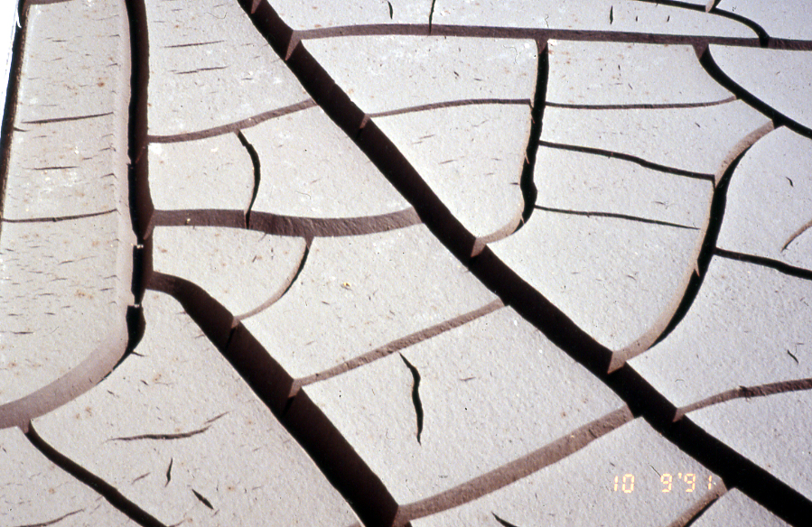
Dewatering
Last stage before disposal or incineration
Similar processes as thickening, semi-dry to dry solid
Dewatering reduces water content to lower hauling and disposal costs
Operators must be able to identify equipment and basic components
Follows digestion, mostly mechanical
Types
  Vacuum Filter Presses
  Belt Filter Presses
  Sludge Drying Beds
  Centrifuges
  Membrane/Filter Plate Presses
Use polymers to condition stabilized sludges

Slide 53
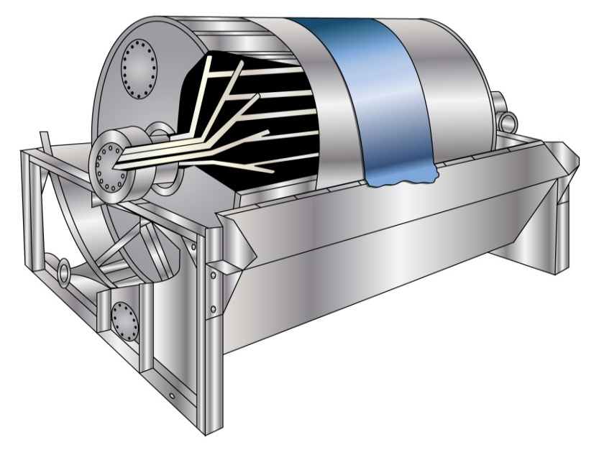
Vacuum Filter Presses
Dewaters the sludge by drawing a cake of sludge onto a belt drum and then sucking the water out of it.
The filter belt rotates through a vat of conditioned sludge and the vacuum draws the sludge onto the belt.
The sludge cake that is picked up on the belt moves out of the sludge vat and into the drying zone.
The vacuum continues to draw air through the sludge cake to dewater it until the belt leaves the drum.
Scraped off of the filter belt and carried by a conveyor to a disposal vehicle.
A set of spray nozzles wash the belt as it returns to the drum.
Produce solids in the 15-24% range
Uses a lot of energy.

Slide 54
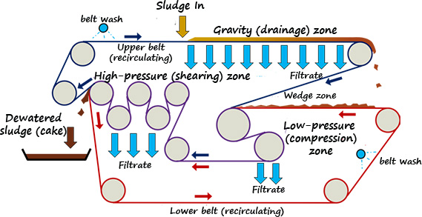
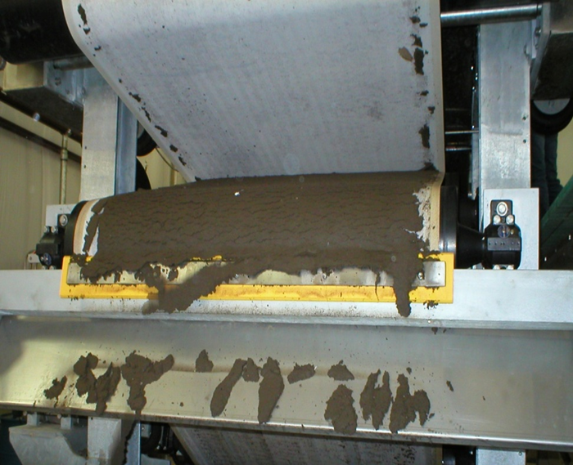
Belt Filter Presses
Most simple and least expensive means of mechanically dewatering sludge
Same process as gravity belt thickener, but sludge is pressed between 2 porous belts controlled by a series of rollers
Sludge cake is then scraped from the belts and sent by conveyer to disposal truck
Set of spray nozzles are used to clean he belt.
Creates another side stream that returns water & filtrate to the head of the plant

Slide 55
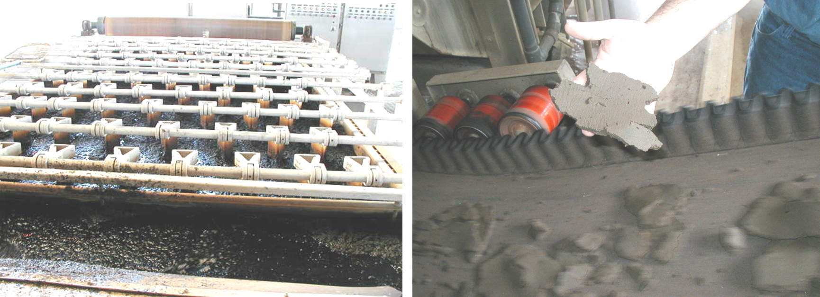
Belt Filter Presses

Slide 56
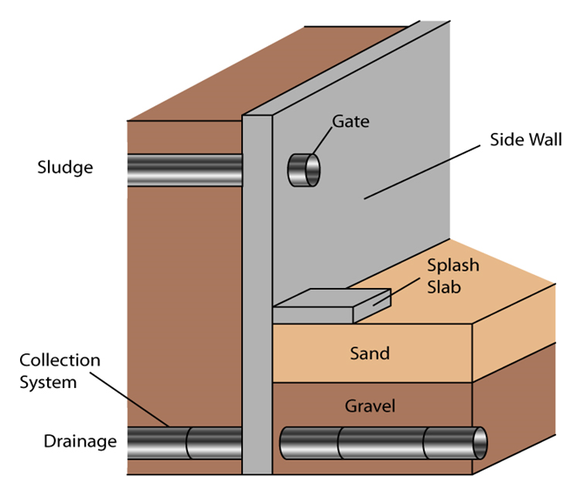
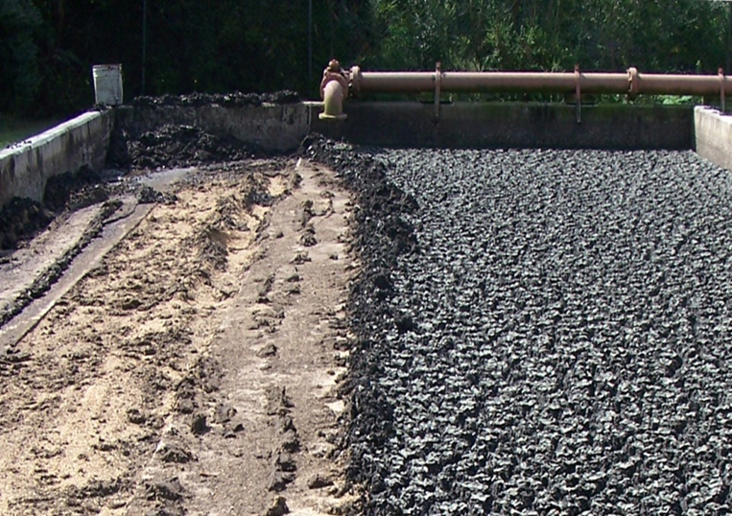
Sludge Drying Beds
Beds are shallow rectangular basins with a sand, asphalt, vacuum tray, or concrete bed and underdrain system
Dries by evaporation and gravity separation of the water
Placed on the bed in 10-12 inch pours
Underdrain valve is opened to allow the water that drains out of the bed to return to the head of the plant
Length of time it takes to dry the sludge will depend on the condition of the sludge and degree of digestion.
Seasonal temperature differences and compaction of the sand bed can also affect drying times.
Never put digester sludge in a drying bed that already has dry sludge in it.
Capable of drying to > 95% Solids
70-80% typical TS%

Slide 57
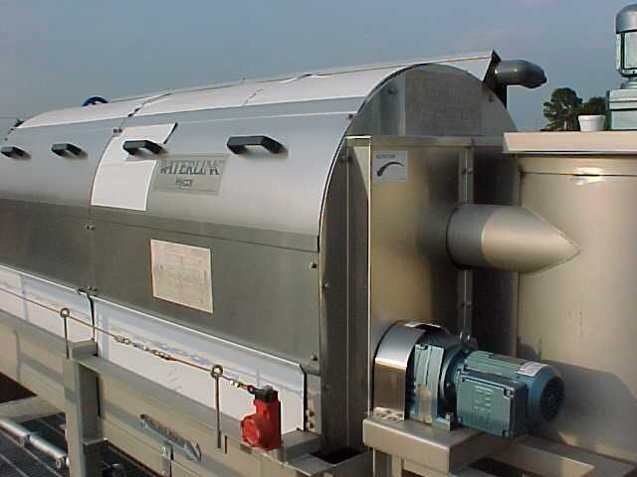
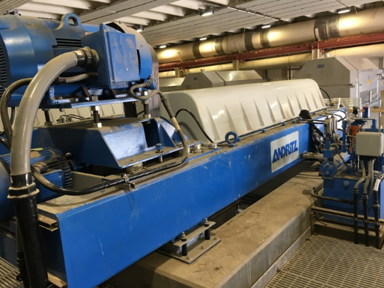
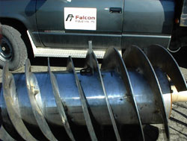
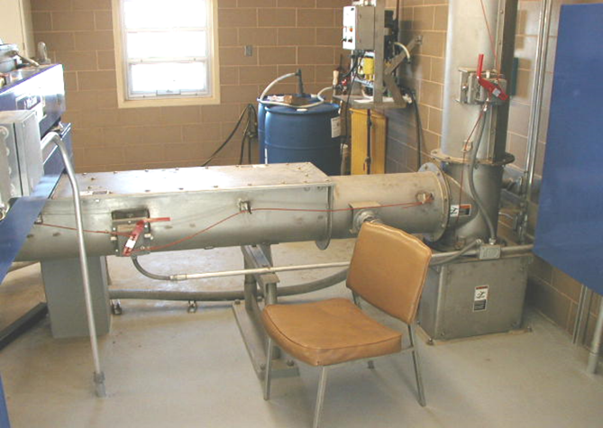
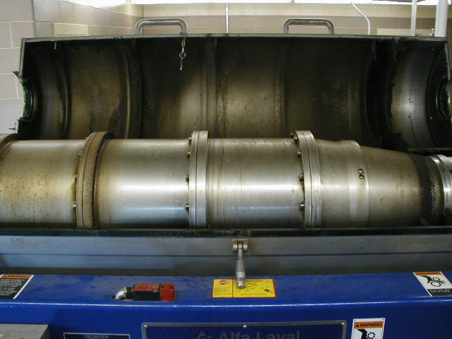
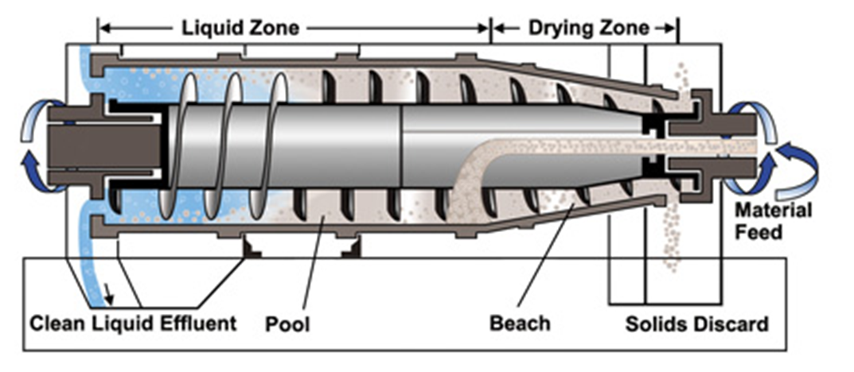
Centrifuges
Centrifuges spin the conditioned sludge and separate the solids from the water by centrifugal force.
Spin cycle of a washing machine or certain carnival rides
2 types of centrifuges:
  Batching centrifuge can only process a single load of sludge at a time
  Scrolling centrifuge is designed to run with a continuous sludge flow.
Conditioned sludge is fed into one end of the centrifuge drum.
Solids are forced to the outside and a scrolling conveyor pushes them out one end of the unit
Water that is left behind, known as centrate, collects in the center and overflows to drain as a side stream
High energy use and hearing hazard
20-40% TS

Slide 58
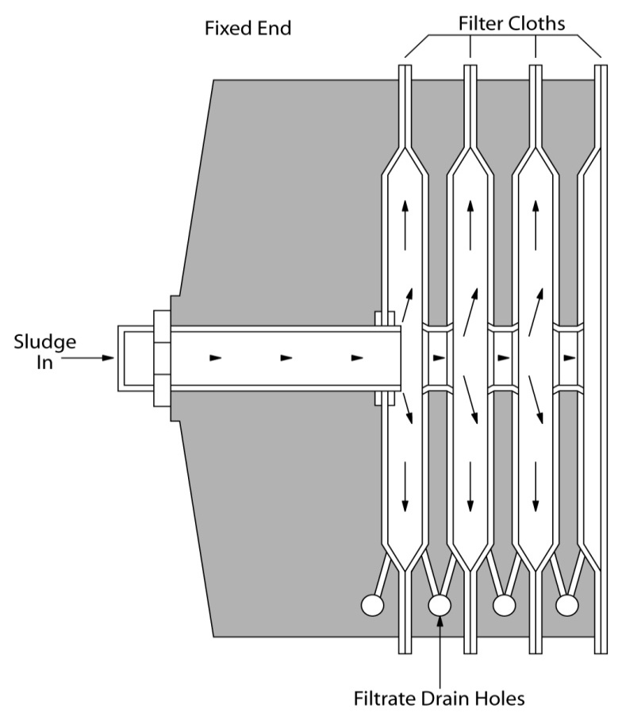
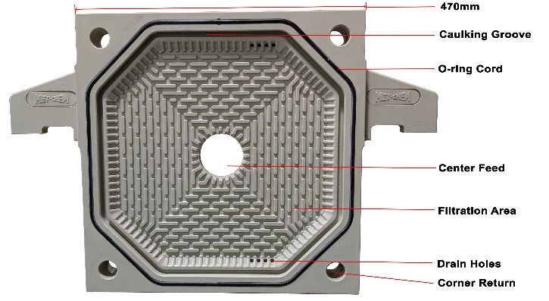
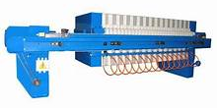
Membrane/Filter Plate Presses
Recessed-plate filter presses are among the oldest types of dewatering devices
Produce the highest cake solids concentration of any mechanical dewatering equipment (35-50% TS)
Two plates are joined to create a chamber to pressurize solids and squeeze out liquid through a filter cloth lining the chamber.
Several plates (ranging from 12 to 80, depending on the capacity required) are suspended from a frame face to face. to form a series of chambers.
Conditioned solids are pumped into the center hole to fill each chamber.
Pressure increased by:
  Adding more conditioned solids (fixed volume press)
  Expanding a membrane (variable volume press)
Solids are retained on the filter cloth while liquid passes through and is drained away from the machine.
Free water is released and passes through the filter cloth during the filling phase.
Pressure builds as the chamber fills with solids beginning the consolidation process
Required filtration pressure (100 psi to 225 psi).
Cake is formed until a set-point of low filtrate flow is reached to indicate the end of the cycle.

Slide 59
Disposal & Reuse

Slide 60
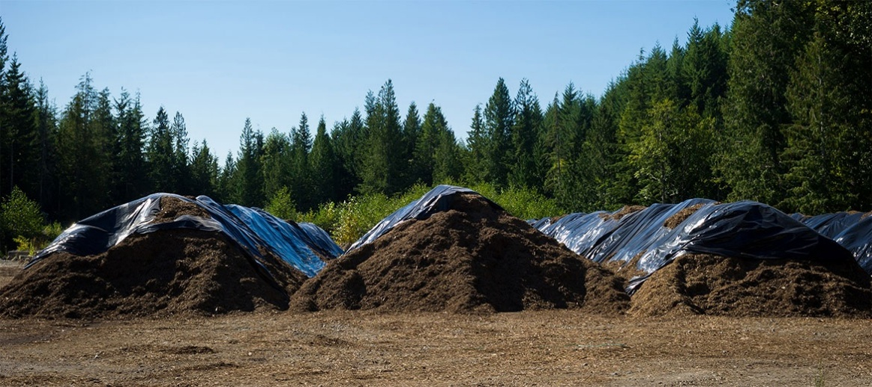
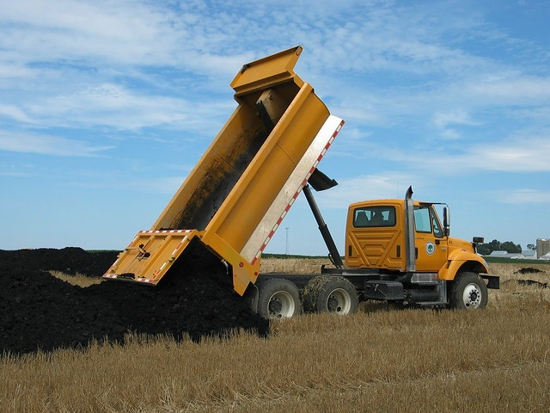
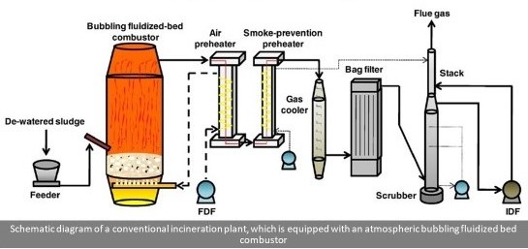

Disposal & Reuse

Slide 61
Disposal & Reuse
Once sufficiently dewatered, sludge is disposed of or reused by:
  Incineration - rare due to Clean Air Act rules
  Sanitary landfill
  Land application
  Composting
Federal regulations for the use or disposal of sewage sludge were promulgated in 1993 under 40 CFR Part 503.
The 503 sludge regulations commonly referred to as '503s'
503 applies to virtually any primary and secondary sludge and scum produced as a result of wastewater treatment and even covers some disposal practices for domestic septage.
503 specifies two types of activity;
  Beneficial use (Reuse)
  Disposal
Permits or approval from:
  EPA
  New Mexico Environment Department’s Ground Water Quality Bureau (NMEDGWQB)
  Surface Water Quality Bureau (NMED-SWQB)
  Solid Waste Bureau (NMED-SWB)
  DOT

Slide 62
Disposal & Reuse
Beneficial use (Reuse)
  Surface Disposal or Land Application, either in bulk or in bags to public contact sites. (includes Composting)
  Land Application, in bulk to non-public contact sites. (includes Composting)
Disposal
  Incineration
  Municipal landfill is an acceptable
    Covered under NM Solid Water Bureau regulations, not 40 CFR 503.
503 sets requirements for:
  Reduction of pathogens
  Reduction of the vector attraction of the sludge
  Pollutant limits for heavy metals and PCBs
  Restrictions for land application and surface disposal sites
  Management practices for land application and surface disposal activities
503 sets a limit on how long sludge can be stored at a wastewater treatment plant before it must be beneficially re-used or disposed.
If sludge remains in storage for more than two (2) years, the site is considered a surface disposal site and all applicable aspects of the 503 regulations must be met, unless the owner/operator can demonstrate the storage constitutes treatment based on operational practices
FAILURE TO ABIDE BY THESE LAWS CAN LEAD TO CIVIL AND EVEN CRIMINAL PROSECUTION.

Slide 63
Sampling & Testing

Slide 64
Sampling & Testing
Operators perform basic sampling and testing of sludge to monitor solids handling and digestion.
Sampling Practices
  Collect representative sludge samples
  Use proper containers and labeling
  Avoid contamination
  Deliver samples promptly for analysis
Tests Performed
  Percent Solids (TS%) – determines dryness and readiness for dewatering or disposal
  pH – ensures sludge is not excessively acidic or alkaline
  Temperature – confirms digestion activity (especially aerobic digestion)
  Dissolved Oxygen (DO) – verifies aerobic digestion conditions
  Odor and appearance – identifies septic sludge, scum, grit, or grease
  Sludge depth/blanket measurements – monitors accumulation in digesters or clarigesters

Slide 65



Sampling
Collect representative sludge samples
  Collected by:
    Sludge Judge used to measure sludge blanket depth and collect vertical profile samples
    Bottle on the end of a pole used to grab samples from tanks or digesters
    Sample port controlled by a valve used to collect sludge directly from piping or draw‑off lines
  Middle zone is the “sweet spot”
    Best mixture of solids and liquid
    Most representative of digested sludge
  Avoid the top layer
    Contains scum, grease, floating solids, gas pockets
  Avoid the bottom layer
    Contains grit, sand, heavy inorganics, overly settled material
  Avoid sampling next to or near
    Injectors (air or chemical)
    Influent/effluent piping unless required

Slide 66

Sampling
Use proper containers and labeling
  Container Selection
    Choose containers based on the test: TS%, pH, temperature, DO, odor/appearance
    Container type depends on the test:
      Glass for chemical stability
      Plastic (PPE) for general sludge samples
      Clear for visual/odor checks
      Darkened/amber for light‑sensitive tests
    Sample Volume
      Collect enough sample to perform all required tests
      Avoid overfilling — leave headspace if temperature or DO will be measured
  Labeling & Chain of Custody (CoC)
    Every sample bottle must be labeled and logged with:
    Date
    Time
    Location / Sample point
    Test(s) to be performed
    Sampler initials
    Permit ID (if required)
  Avoid contamination

Slide 67
Sampling
Proper delivery ensures sludge samples remain valid for testing.
Delivery Requirements
  Know the test timing
    Some tests must be run within 15 minutes of collection (temperature, DO, odor/appearance).
  Cooling / Ice
    If required, place samples on ice immediately to slow biological activity and preserve accuracy.
  Avoid shaking
    Shaking can introduce oxygen, disturb solids, or alter DO and temperature readings.
  Avoid sunlight
    Heat and UV exposure can change sample chemistry and invalidate results.
  Transport quickly
    Deliver samples to the lab as soon as possible unless the test is performed on‑site.
On‑Site Testing
  Some parameters (temperature, DO, odor/appearance) are best done immediately at the sampling point.

Slide 68



Testing
Direct Read:
  An instrument that gives you the value and no calculations are necessary
  Examples:
    pH meter (no units)
    Dissolved Oxygen Probe (DO), mg/L
    Temperature, ˚F or ˚C
    Chlorometer (Chlorine) mg/L
  Must perform calibration check prior to sampling
  every day before 1st use
  Be aware that not all procedures are approved by the EPA or TCEQ
  EPA compliant DOES NOT mean approved
  When in doubt, check the record. 40 CFR §136.3
  https://www.ecfr.gov/current/title-40/chapter-I/subchapter-D/part-136/section-136.3

Slide 69
Solids Analyses

Slide 70
Solids Analyses
Solids are important in several aspects of wastewater treatment
Organic Solids:
  Another name is Volatile Solids
  Are either living matter or the byproducts of previously living organisms
  Will burn up in the muffle furnace, resulting in a decrease in weight, proportional to the amount of organics present
Inorganic Solids:
  Mostly consist of minerals found in the drinking water, as well as grit, sand, salts & other inorganic matter that entered the collection system
  Inorganic solids will NOT burn in the muffle furnace.
Total Solids (TS) includes both categories of solids:
  Organics and Inorganics in all solids
  Suspended Solids (TSS)
    Include those solids that can be filtered out of the aqueous fraction and weighed
    Suspended solids are considered Settleable Solids because they will settle out in the Imhoff Cone test, expected to also settle out in a Primary Clarifier.
  Dissolved solids (TDS)
    Can NOT be filtered out of a sample
    Makes up about 40% of total solids
    Responsible for conductivity, salinity, and other factors that affect water quality

Slide 71


Solids Analyses
TS/VS, TSS/VSS:
All solids analyses use the same formula
Each procedure is a little different, but the calculations are the same. All involving measuring, drying, & weighing
TS/VS
  Well mixed sample measured in graduated cylinder
  Placed in evaporating dish
TSS/VSS
  Well mixed sample vacuum filtered
  Weigh filter paper and solids

Slide 72
QR Code to download pdf handout for slides and practice exam.

